Slide 1



Greenhouse Gas Emission Prediction

Slide 2

Learning Objectives
The objective of Greenhouse Gas (GHG) Emission Prediction is to understand the sources and impacts of greenhouse gases like CO₂, CH₄, and N₂O, and to develop data-driven models that can forecast future emissions accurately. It involves collecting and preprocessing relevant environmental and industrial datasets, engineering meaningful features, and applying machine learning or deep learning models to predict emission trends. Learners aim to evaluate model performance using metrics like RMSE and R², interpret results to support policy decisions, and communicate findings through effective visualizations. Ultimately, the goal is to enable sustainable decision-making by using AI to address climate challenges and promote long-term environmental responsibility.
GOAL
Source :
www.freepik.com/

Slide 3
Tools and Technology used
Programming Language: Python – for data analysis, modeling, and visualization
Libraries & Frameworks: Pandas, NumPy, Scikit-learn, Matplotlib, Seaborn, XGBoost, TensorFlow/Keras
Data Sources: Kaggle, World Bank, UNFCCC, EPA – for historical GHG and climate data
Data Storage: CSV files, SQLite, MySQL – for storing and managing datasets
Development Environment: Jupyter Notebook, Google Colab – for interactive coding and model building
Version Control: Git, GitHub – for code tracking and collaboration
Visualization & Reporting: Power BI, Tableau, MS Excel, PowerPoint – for insights and presentation

Slide 4
Methodology
The methodology of the Greenhouse Gas Emission Prediction project involves a structured pipeline starting with data collection from reliable sources such as the World Bank, UNFCCC, EPA, or Kaggle, which includes historical data on greenhouse gas emissions, energy consumption, population, industrial activity, and other related variables. After acquiring the data, preprocessing steps are performed such as handling missing values, normalizing numerical features, and encoding categorical variables to prepare the data for modeling. Exploratory Data Analysis (EDA) is conducted to understand trends, correlations, and distributions within the dataset. Next, relevant features are selected or engineered to improve model performance. Various machine learning models such as Linear Regression, Random Forest, XGBoost, or deep learning models like LSTM (for time-series prediction) are trained and evaluated using metrics like RMSE, MAE, and R² score. Hyperparameter tuning and cross-validation techniques are applied to enhance the accuracy and generalizability of the model. Once the best-performing model is selected, it is used to predict future GHG emission trends under different scenarios. The results are then visualized using graphs and dashboards, and insights are interpreted to support data-driven policy-making and sustainability efforts. Finally, a detailed report is prepared to document the entire workflow, findings, and possible recommendations for emission reduction strategies.

Slide 5
Problem Statement:
The problem of increasing greenhouse gas (GHG) emissions poses a significant threat to global climate stability, leading to rising temperatures, extreme weather events, and long-term environmental degradation. Governments, industries, and researchers face challenges in accurately tracking and forecasting these emissions to support effective policy-making and sustainable development goals. Traditional methods of emission estimation often lack real-time analysis, predictive insights, and adaptability to complex variables like energy consumption, population growth, industrial activity, and land use changes. Therefore, this project aims to develop a data-driven predictive model using machine learning techniques to estimate future GHG emission trends based on historical environmental, industrial, and socio-economic data. By analyzing key emission drivers and forecasting future patterns, the project seeks to provide actionable insights for decision-makers, enabling them to implement proactive strategies for emission reduction and climate resilience.

Slide 6
Solution:
The solution to the Greenhouse Gas Emission Prediction project involves developing a data-driven model that accurately forecasts future emissions based on historical and environmental data. The process begins with collecting datasets from reliable sources such as the World Bank, UNFCCC, and EPA, which include information on energy consumption, industrial output, transportation, agriculture, and population. These datasets are then cleaned, merged, and preprocessed using Python libraries like Pandas and NumPy. Feature engineering is applied to identify the most relevant indicators influencing GHG emissions. Various machine learning algorithms such as Linear Regression, Random Forest, and XGBoost are trained and evaluated using metrics like RMSE and R² score to select the most effective model. Deep learning techniques using LSTM models may also be employed to capture temporal patterns in emissions data. Once trained, the model is used to predict future emissions under different scenarios, helping to identify key sectors contributing to climate change. The results are visualized using tools like Matplotlib, Power BI, or Tableau to support clear and impactful communication. This solution not only aids in understanding emission trends but also empowers policymakers, industries, and environmental researchers to make informed, sustainable decisions aimed at reducing the global carbon footprint.

Slide 7
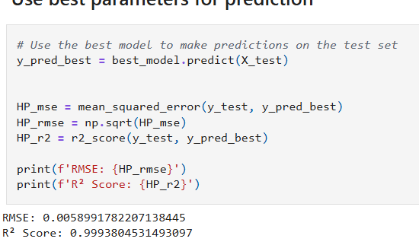
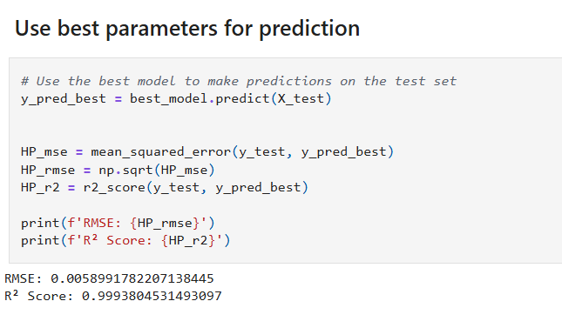
Screenshot of Output:

Slide 8
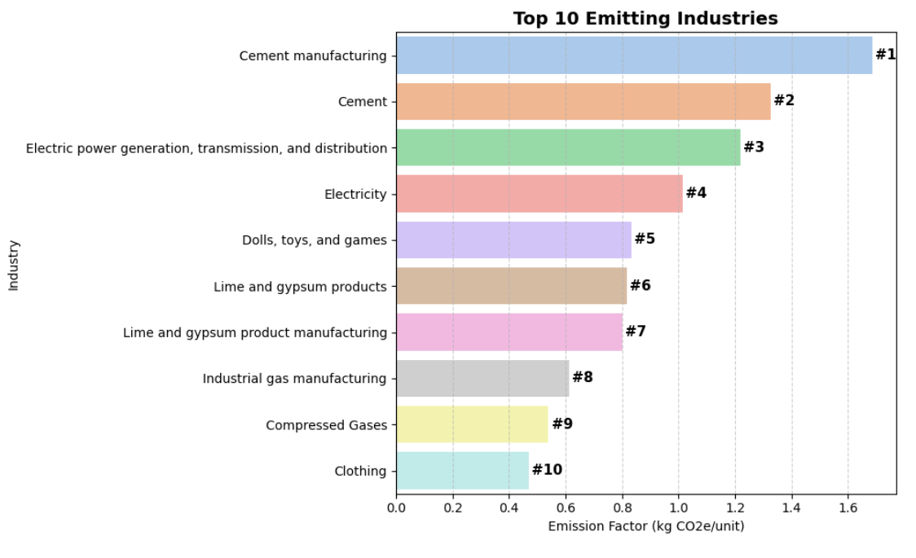
Screenshot of Output:

Slide 9
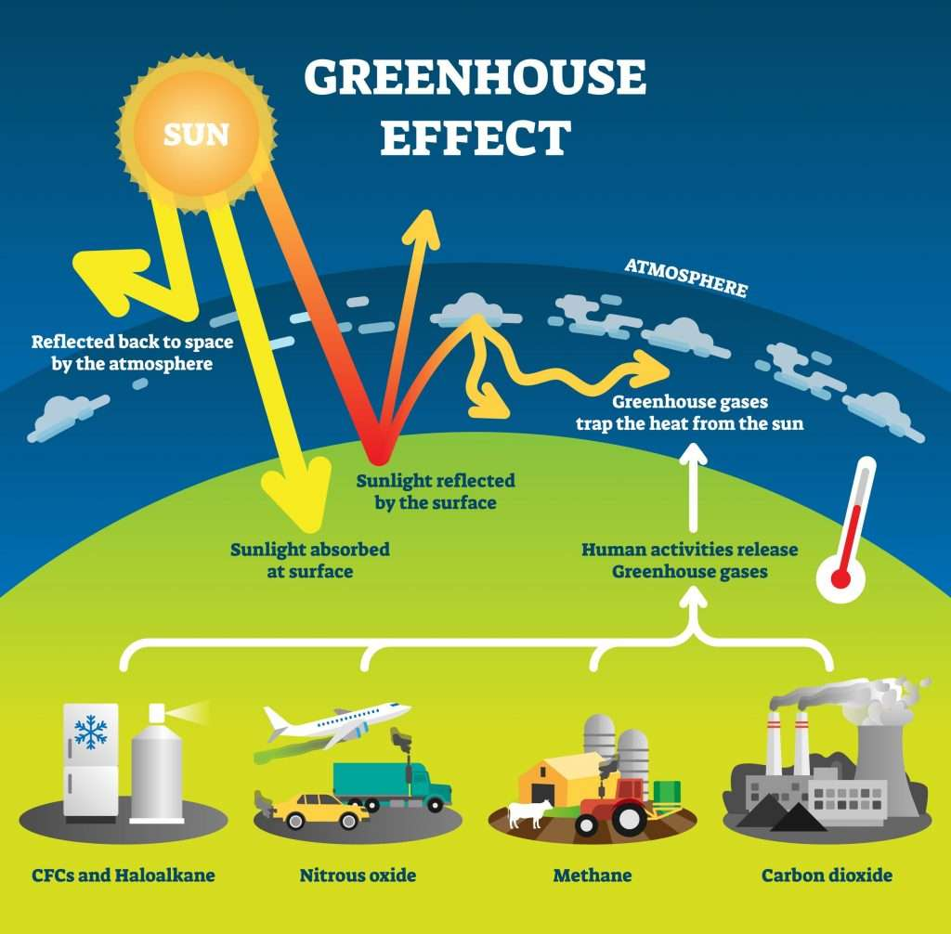
Screenshot of Output:

Slide 10
Conclusion:
In conclusion, the Greenhouse Gas Emission Prediction project plays a critical role in addressing the global challenge of climate change by leveraging data science and machine learning techniques to forecast future emission trends. Through the collection and preprocessing of reliable environmental and industrial data from trusted sources like the UNFCCC, EPA, and World Bank, the project enables the development of accurate predictive models using tools such as Python, Scikit-learn, and TensorFlow. By applying regression and deep learning algorithms, the model helps identify key factors influencing GHG emissions and provides insights into future scenarios under different policy or behavioral changes. The use of visualization tools like Power BI and Tableau further enhances the interpretability of results, making them accessible to policymakers, researchers, and environmental stakeholders. Ultimately, the project not only demonstrates the power of AI in environmental monitoring but also contributes to evidence-based decision-making for sustainability, climate resilience, and global carbon reduction strategies.

